Slide 1
Intrusion detection system

Slide 2

Presentation On
INTRUSION DETECTION SYSTEM
Bachelor Of Technology
In
Computer Science & Engineering
By
Harsh Kr. Gaurav (19105125003)
Mrinal Prakash
(19105125020)
Amar Kr. Sharma
(19105125055)
Vikash Raj
(19105125056)
Under The Guidance
Of
Asst. Prof. Ravi Kumar
Department of computer Science & Engineering
Rashtrakavi Ramdhari Dinkar College of Engineering , Begusarai

Slide 3
OVERVIEW
Purpose
Objective
It aims to detect unauthorized access, malicious behaviour, and potential security in real-time or near real-time.
It helps organizations protect their digital assets, and sensitive data.
strategic points within a network to monitor and analyse incoming and outgoing traffic.
Traffic Monitoring: capturing packets as they traverse through the network.
Packet Analysis: looking for patterns and characteristics that match unusual behaviour.
Signature-Based Detection: uses a database of predefined attack signatures to match against the traffic.

Slide 4
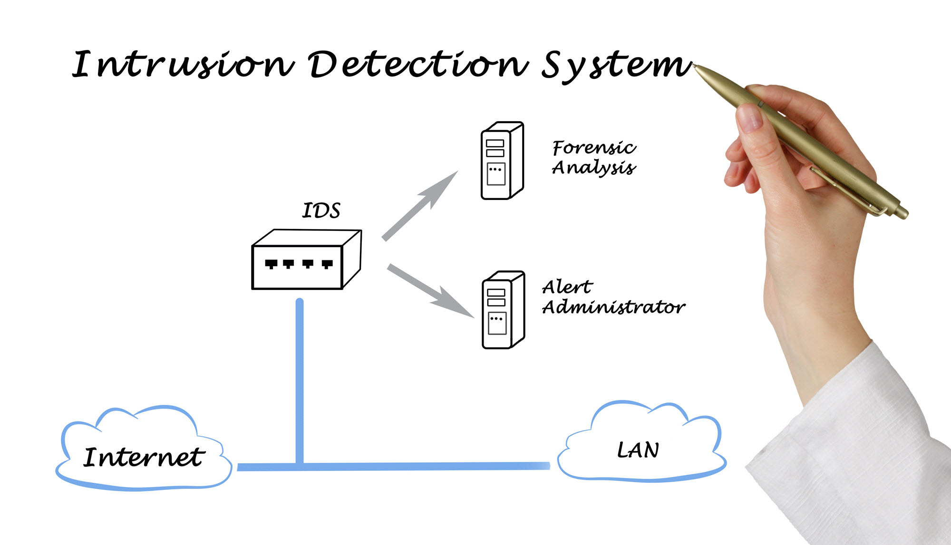
INTRODUCTION TO IDS
It is a security technology designed to monitor and detect unauthorized malicious activities within a computer network or system.
Used to identify and respond to potential security breaches, including unauthorized access attempts, network attacks, and policy violations.
IDS is capable of detecting malicious activities that cannot be detected by conventional firewalls.

Slide 5
Why We need this
Using of Internet is increasing day by day.
The transfer of information need to be secure in present scenario.
It is a security technology designed to monitor and detect unauthorized malicious activities within a computer network or system.
Used to identify and respond to potential security breaches, including unauthorized access attempts, network attacks, and policy violations.

Slide 6

USE OF IDS’S
Detecting Malware and Ransomware
Unauthorized Access Attempts
Insider Threat Detection
Data Leakage Prevention
Cloud Security Monitoring
Network Scanning and Port Scanning

Slide 7

Different Ways to Intrude
Buffer Overflows
Unexpected Combinations
Unhandled Inputs
Race Conditions

Slide 8
Types of Intrusion Detection Systems​
Network-Based Intrusion Detection System (NIDS)
Host-Based Intrusion Detection System (HIDS)
Signature Based system
Anomaly Based system
Intrusion Detection System
Host-Based IDS
Network Based IDS
Application Based IDS

Slide 9
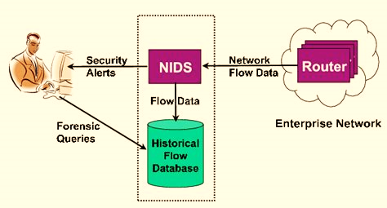
Network-based IDS (NIDS)
These systems monitor network traffic, analyzing packets and looking for patterns or signatures of known attacks.
NIDS monitors and analyzes network traffic to detect suspicious or malicious activities within a network.
It is typically deployed at strategic points within the network, such as at the network perimeter or within critical segments.
NIDS examines network packets, headers, and payloads to identify patterns or signatures of known attacks or anomalies.
It is particularly useful for detecting attacks that traverse the network, such as network scanning, port scanning, and denial-of-service (DoS) attacks.
Advantages:
NIDS can monitor the entire network, providing visibility into all devices, servers, and endpoints connected to it.
NIDS can handle large amounts of network traffic.
NIDS can quickly detect and respond to network-based attacks.
Disadvantages:
NIDS may not have access to specific details of host-level activities.
NIDS may face challenges in monitoring encrypted network traffic.

Slide 10
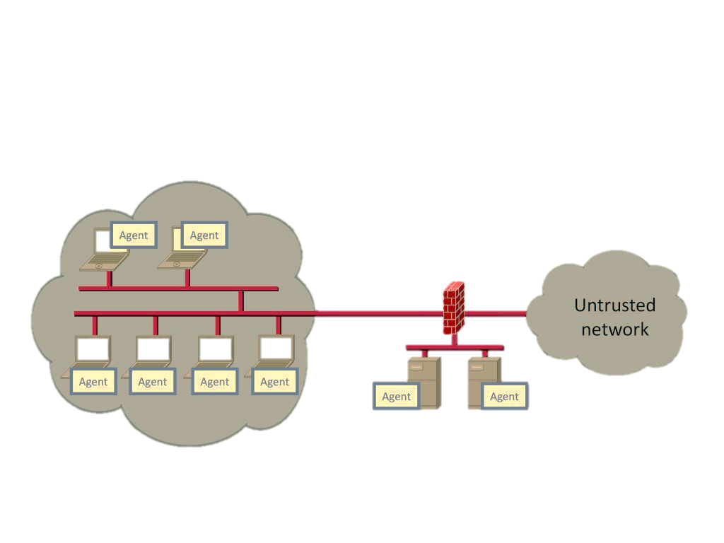
Host-based IDS (HIDS)
HIDSs focus on detecting malicious activities that may bypass network-based security measures, such as unauthorized file modifications, abnormal user behaviour, or the presence of malware.
HIDS is deployed on individual hosts or endpoints to monitor their activities and detect potential intrusions or suspicious behaviors.
It runs directly on the host's operating system and collects data about processes, files, registry changes, and user activities.
HIDS can detect attacks that may go unnoticed by NIDS, as it focuses on activities specific to the host, such as unauthorized file modifications or privilege escalation attempts.
HIDS is effective in detecting insider threats, malware infections, and attacks targeting specific hosts.
Advantages:
It reduces false positive and improve accuracy.
It can detect unauthorized actions or usual behaviour.
Disadvantages:
Complexity increases during implementing and managing
Cost also increases compared to other ids`s.

Slide 11
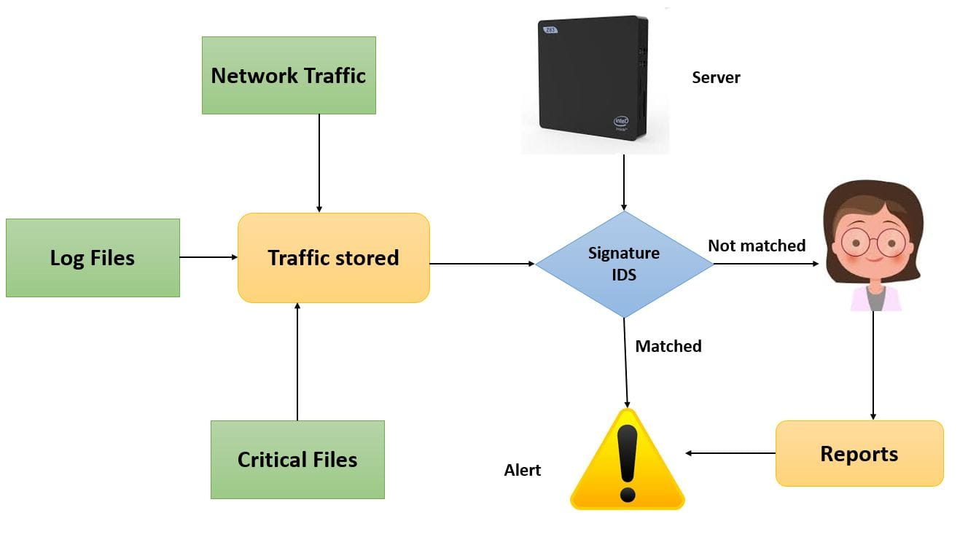
SIGNATURE BASED SYSTEM
These signatures are predefined and typically based on characteristics of known malware, exploits, or intrusion attempts.
Advantages
Anomaly Id’s is capable of detecting new unknown.
Disadvantages
Large Signature Databases
Limited Protection Against New Threats

Slide 12
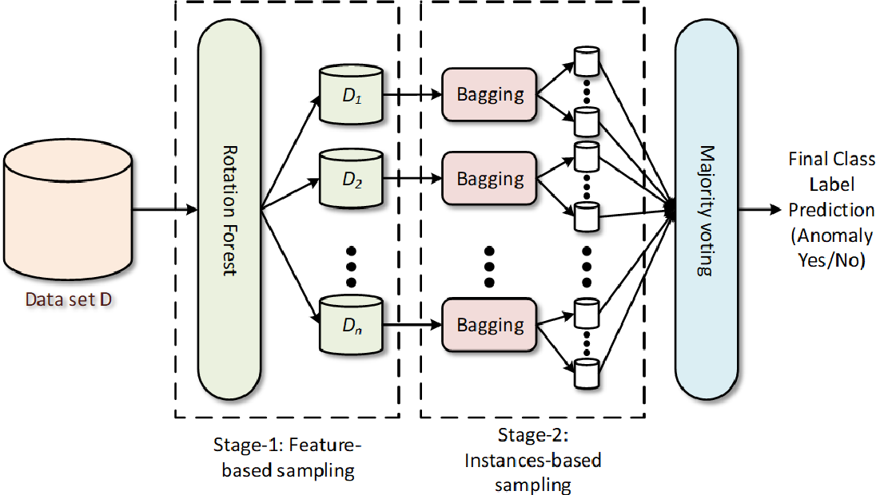
ANOMALY BASED SYSTEM
The IDS creates a baseline of normal activities by monitoring and analyzing the historical data and behaviour patterns.
Advantages:
Anomaly ids is capable of detecting new unknown threat.
Disadvantages:
It generates high false positive.
Inability to detect novel attacks.

Slide 13
Tools & Techniques
Machine Learning Algorithm
Supervised Learning
Logistic Regression
Decision Tree
Random Forest
SVM
Libraries and framework
Numpy
Pandas
Matplotlib
Flask
Frontend Tools Used
HTML
Bootstrap
CSS

Slide 14
SYSTEM ARCHITECTURE
Pre-processing
Pandas: A powerful Python library for data manipulation and cleaning.
NumPy: A library for numerical computing in Python, often used for handling arrays and mathematical operations.
Feature Extraction
Scikit-learn: A comprehensive machine learning library in Python that includes various feature extraction techniques.
tshark: A command-line utility that can extract specific fields from packet capture files.
Model Selection and Training
Scikit-learn: Offers a wide range of machine learning algorithms for classification, such as Decision Trees, Random Forest, SVM, etc.
TensorFlow or PyTorch: Popular deep learning frameworks used for building and training neural networks.
Model Evaluation
Scikit-learn: Provides tools for model evaluation, including functions for calculating accuracy, precision, recall, F1 score, etc.
K-fold Cross-validation: A technique used to evaluate the model's performance on different subsets of the data

Slide 15
Real-Time Monitoring
Snort: An open-source IDS that can be used for real-time traffic analysis and packet logging.
Suricata: Another open-source IDS that can perform real-time intrusion detection and prevention.
Alerting Mechanism
Email Alerts: Configure the system to send email notifications when suspicious activities are detected.
Syslog: Send alerts to a centralized logging server for further analysis.
Response Mechanism
Security Incident and Event Management (SIEM) tools: Assist in handling and responding to security incidents effectively.
Deployment and Monitoring
Docker: Containerization tool that simplifies the deployment and scaling of the IDS system.
Grafana and Prometheus: Monitoring tools for visualizing system performance and metrics.
Reporting and Analysis
Jupyter Notebook: An interactive computing environment that allows for data analysis, visualization, and reporting.
ELK Stack (Elasticsearch, Logstash, Kibana): A powerful combination for log analysis and visualization.

Slide 16
ATTACK TYPES
An attack is defined as the unknown network introduced to the computer.
Denial-of-Service
A Denial-of-Service (DoS) attack is a cyberattack in which the attacker seeks to make a network, system, or service unavailable to its intended users. The primary goal of a DoS attack is to overwhelm the target's resources, such as bandwidth, CPU, memory, or disk space, causing the target to become slow or unresponsive, or even crash altogether. By rendering the target unavailable, the attacker disrupts its normal operation, leading to service disruptions or downtime.
Probe
Probe refers to the initial stage of a cyberattack, where the attacker attempts to gather information about the target network or system to identify potential vulnerabilities or weaknesses. The goal of the probe is to gather intelligence that can be used for subsequent stages of the attack.
R2L
An R2L (Remote-to-Local) attack is a type of cyberattack in which the attacker attempts to gain unauthorized access to a local system or network from a remote location. In R2L attacks, the target system is usually a well-protected server or host, and the attacker is external to the local network.
U2L
A U2L (User-to-Local) attack is a type of cyberattack in which a user account on the network tries to gain unauthorized access to a local system or host within the same network. Unlike R2L attacks, U2L attacks originate from within the local network, typically by a user with valid credentials but malicious intent.

Slide 17
FLOW DIAGRAM IMPLEMENTING PROCESS
Data Collection: Collect raw network traffic data from various sources (e.g., logs, packets). Pre-process and clean the data to remove noise and irrelevant information.
Feature Extraction:
Extract relevant features from the pre-processed data. Use domain knowledge and feature engineering techniques.
Data Splitting Divide the dataset into training and testing sets. Reserve a portion for model evaluation.
Model Training Train the selected models using the training dataset. Tune hyperparameters for better performance..
Model Selection Choose appropriate machine learning algorithms for IDS (e.g., Decision Trees, Random Forest, SVM, Deep Learning). Consider the nature of the data and the specific requirements of the system
Model Evaluation: Evaluate the trained models using the testing dataset. Measure performance metrics (e.g., accuracy, precision, recall, F1 score).
Real-Time Monitoring: Implement the trained model in a real-time monitoring system. Continuously analyse incoming network traffic.
Deployment Deploy the IDS in the target network environment. Ensure integration with existing network infrastructure.
Reporting and Analysis Generate regular reports on intrusion detection performance. Analyze trends and patterns to improve the system.

Slide 18
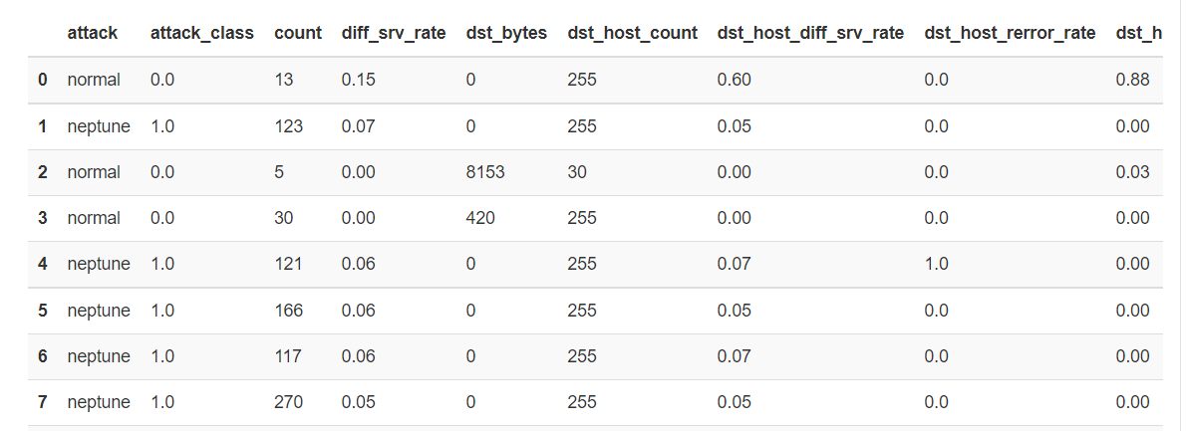
Data Set Used
Purpose:
The main purpose of the KDD Cup 1999 dataset was to encourage research and development in the area of intrusion detection systems.
The KDD Cup 1999 dataset consists of a large collection of network traffic data, known as the "Intrusion Detection Evaluation Dataset (or DARPA dataset)."
It was generated by the Defence Advanced Research Projects Agency (DARPA) to simulate a military network environment. The dataset is a time-series dataset containing network connection records.
Challenges :
Imbalanced Classes
Large Dimensionality: contains a large number of features
The dataset's simulated nature and the emergence of new attack vectors and techniques have made it less representative of real-world network traffic and modern cyber threats.

Slide 19
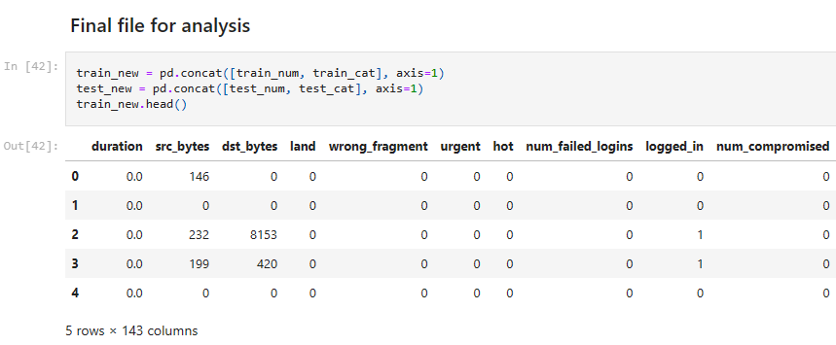
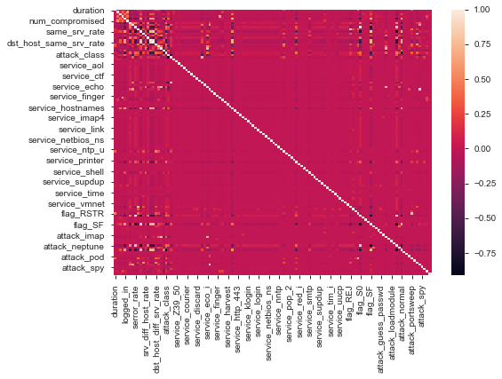
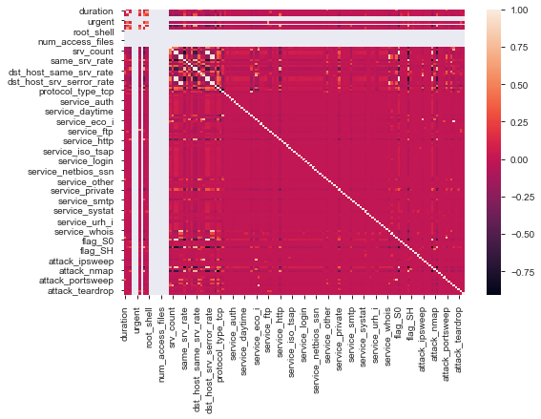
Feature Selection
Feature selection based on correlation and heatmap

Slide 20
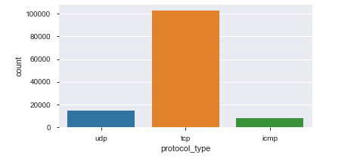
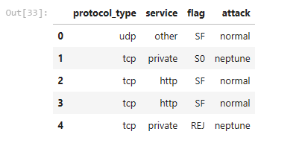
Analysis
Most of the attack was base on tcp protocol followed by udp and icmp
Attack and labelling as flag

Slide 21
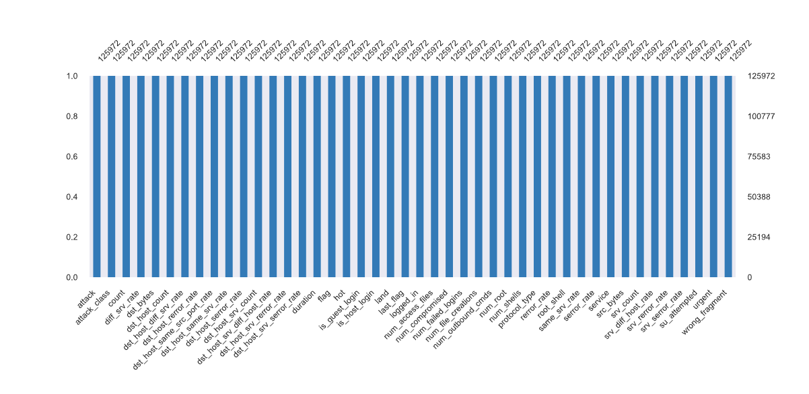
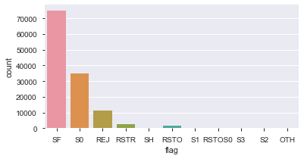
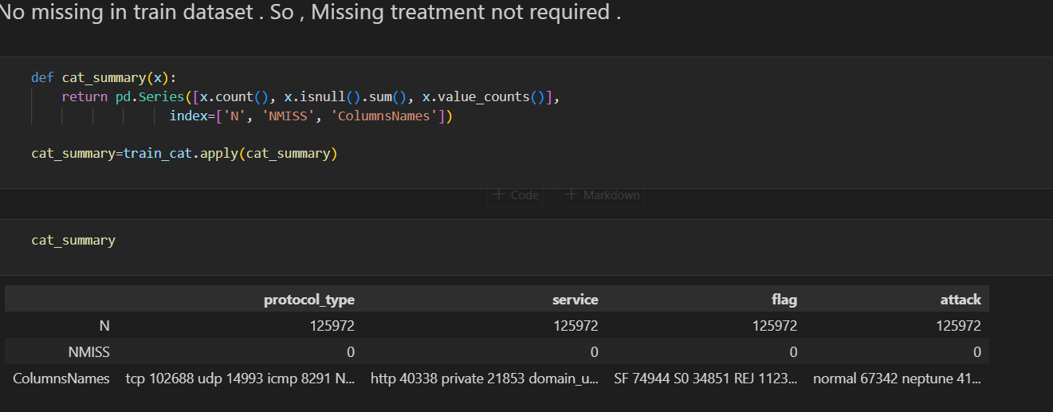
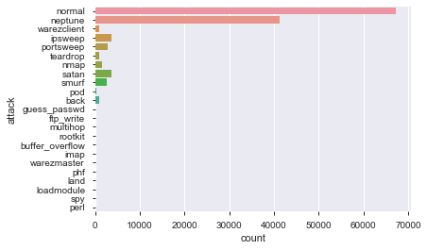
Analysis

Slide 22
MACHINE LEARNING METHODS
Logistic Regression:
It is a binary classification algorithm used to predict the probability of a binary outcome. It models the relationship between a dependent variable and one or more independent variables by estimating probabilities using the logistic function.
K-Nearest Neighbor's:
K-Nearest Neighbors is a simple and intuitive classification algorithm used for both classification and regression tasks. The value of K is a hyperparameter that needs to be set before training the model. KNN is effective for data with non-linear decision boundaries.

Slide 23
MACHINE LEARNING METHODS
Decision Trees:​​
Decision Trees are a non-linear supervised learning algorithm used for both classification and regression tasks. It creates a tree-like model where each internal node represents a decision based on a feature, each branch represents an outcome of the decision, and each leaf node represents a class label or a value.
Support Vector Machine (SVM):​​
Support Vector Machine is a powerful supervised learning algorithm used for classification and regression tasks. SVM tries to find the optimal hyperplane that best separates data points of different classes in the feature space.
Random Forest:​​
Random Forest is an ensemble learning method that combines multiple decision trees to improve the accuracy and reduce overfitting. Each tree in the forest is trained on a random subset of the data and a random subset of features. The final prediction is made by averaging the predictions of all the individual trees in the forest.

Slide 24
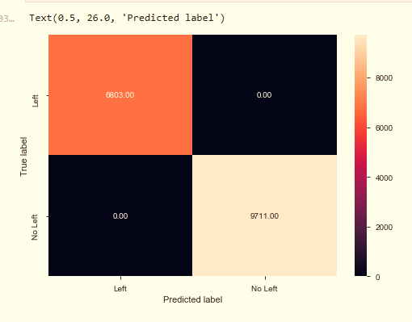
Result And Evaluation
Methods | Accuracy (%)
Logistic Regression | 83.76
K-Nearest Neighbours | 75.38
Decision Trees | 99.85
Support Vector Machines | 81.00
Random Forest | 83.69

Slide 25
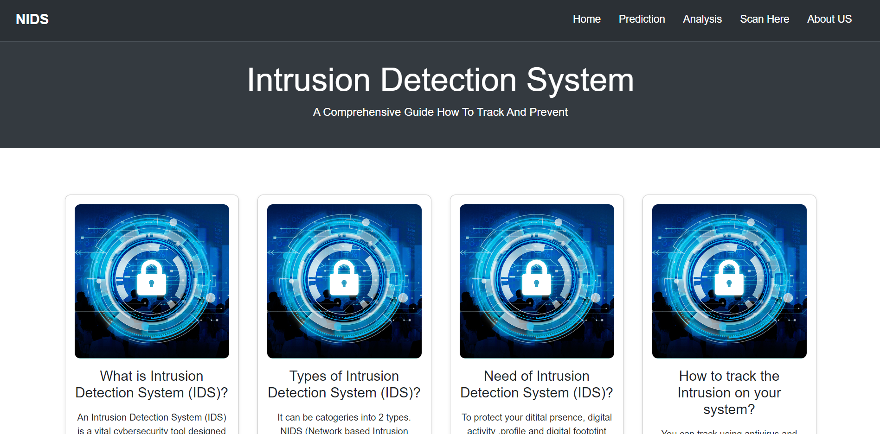
User Interface

Slide 26
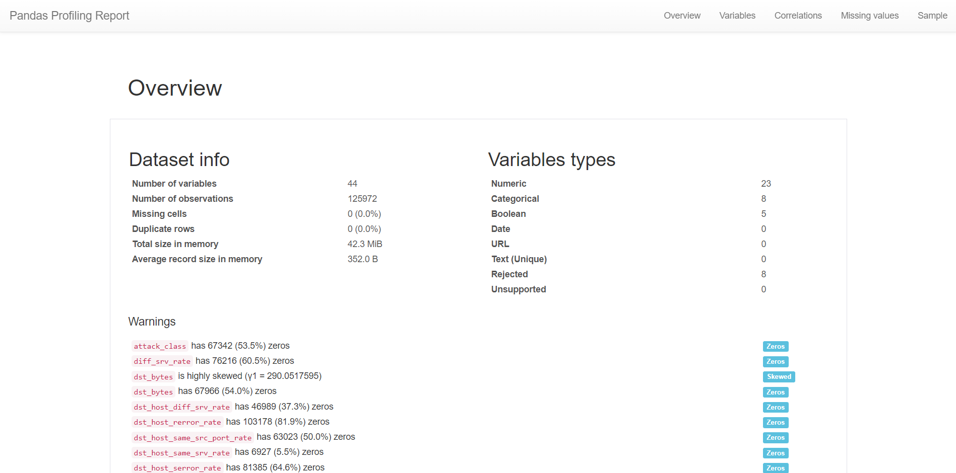
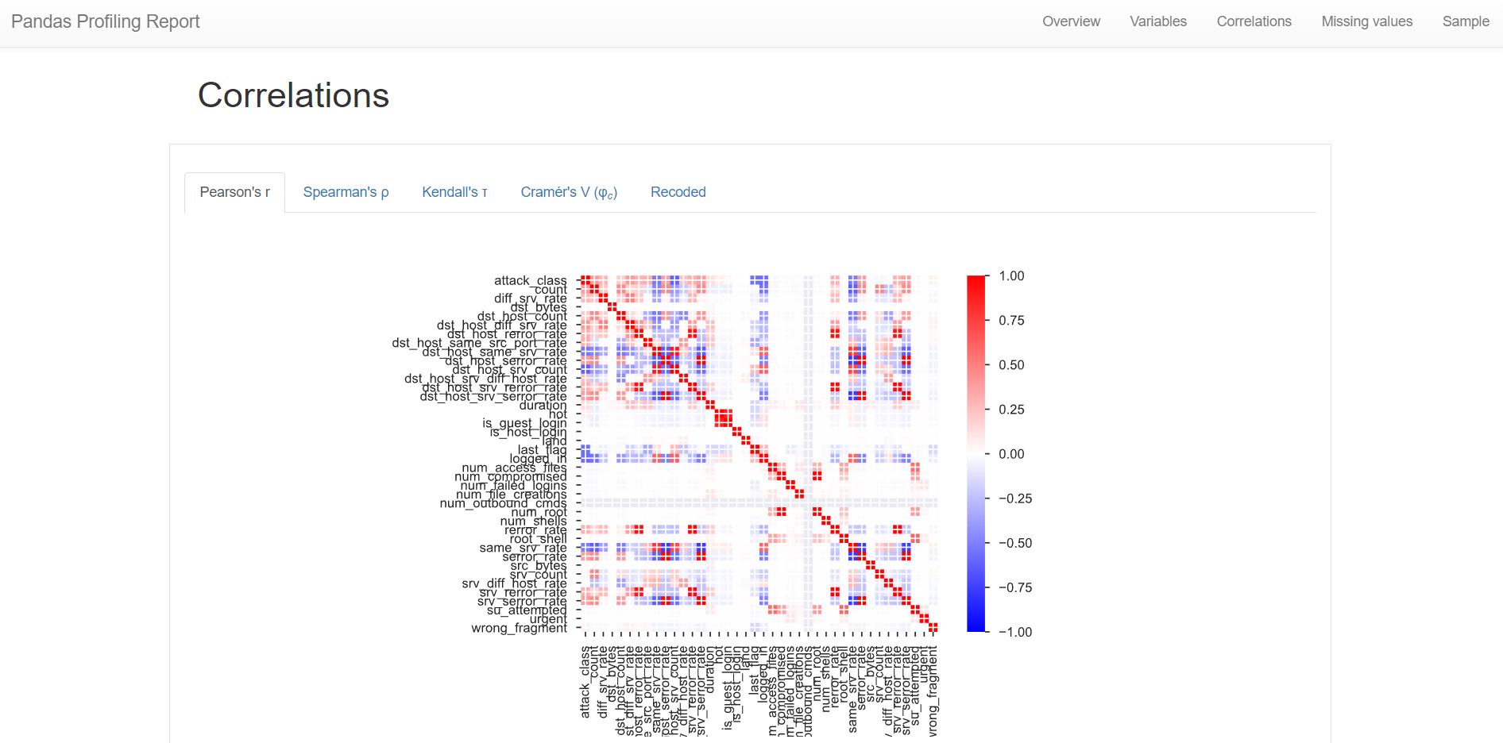
Pandas profiling page

Slide 27
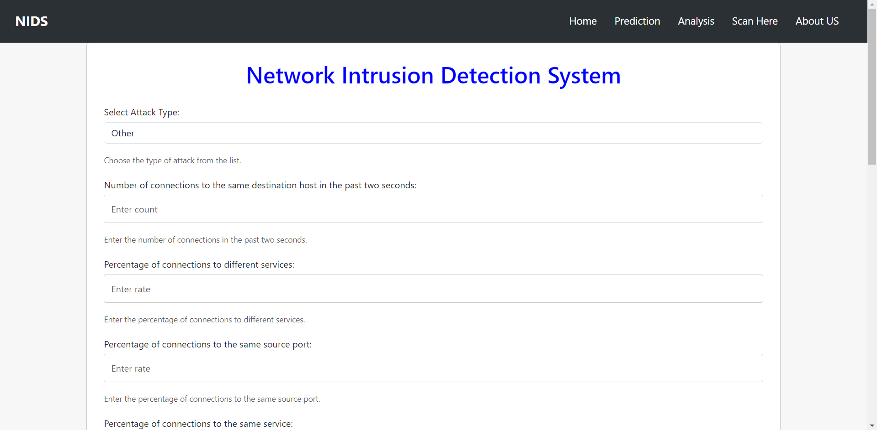
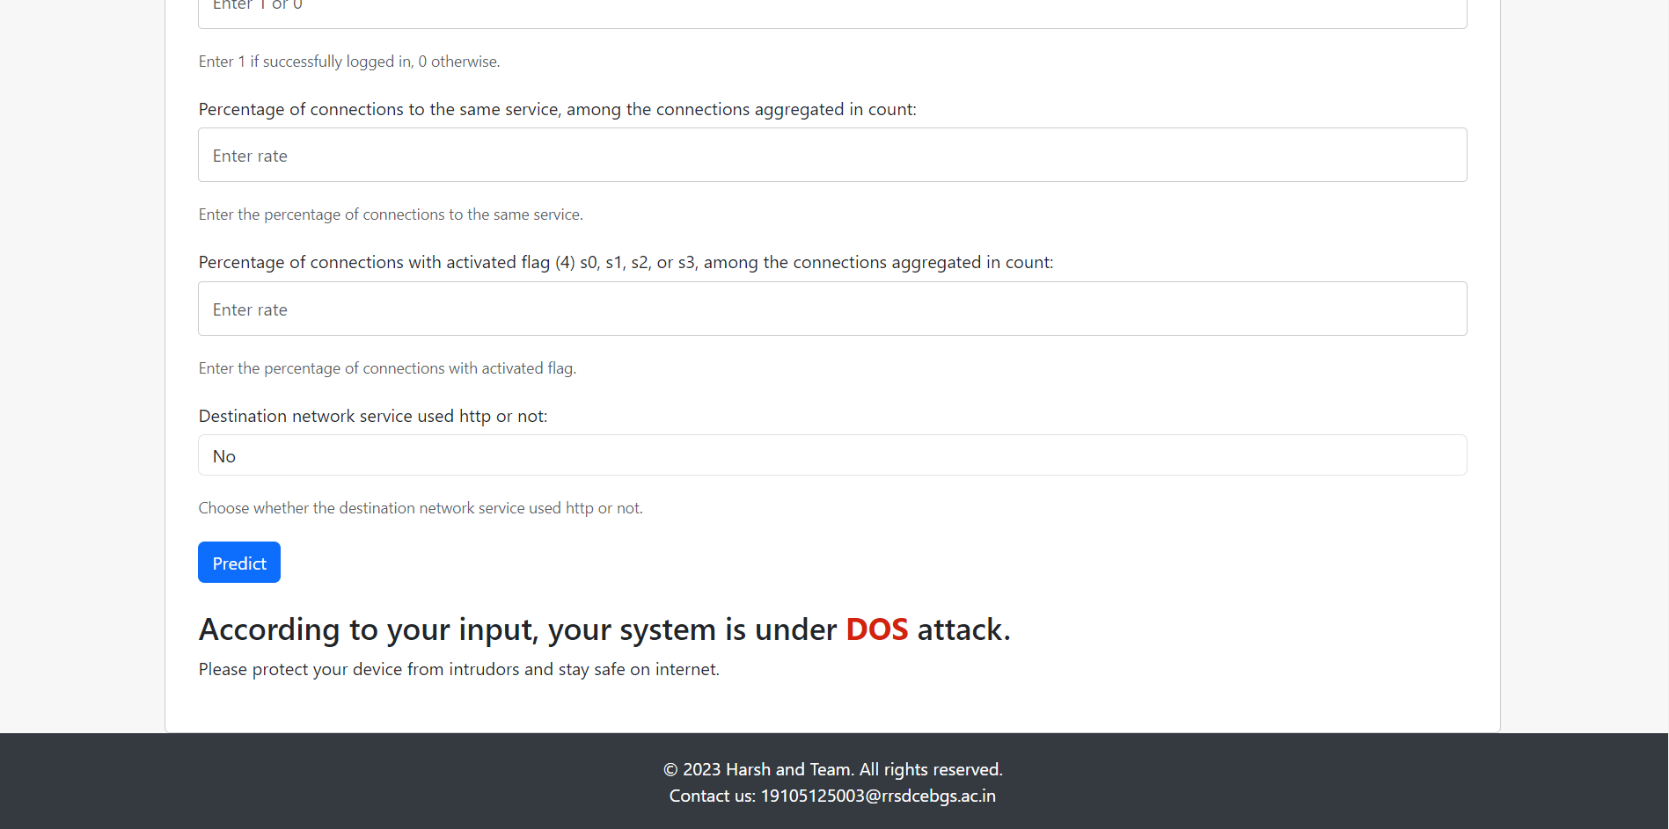
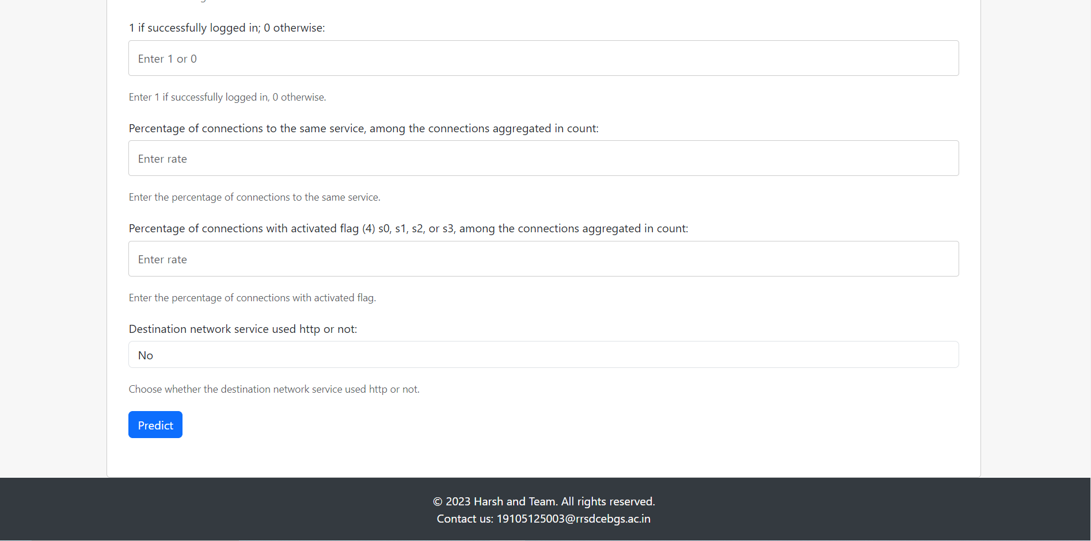
Prediction

Slide 28
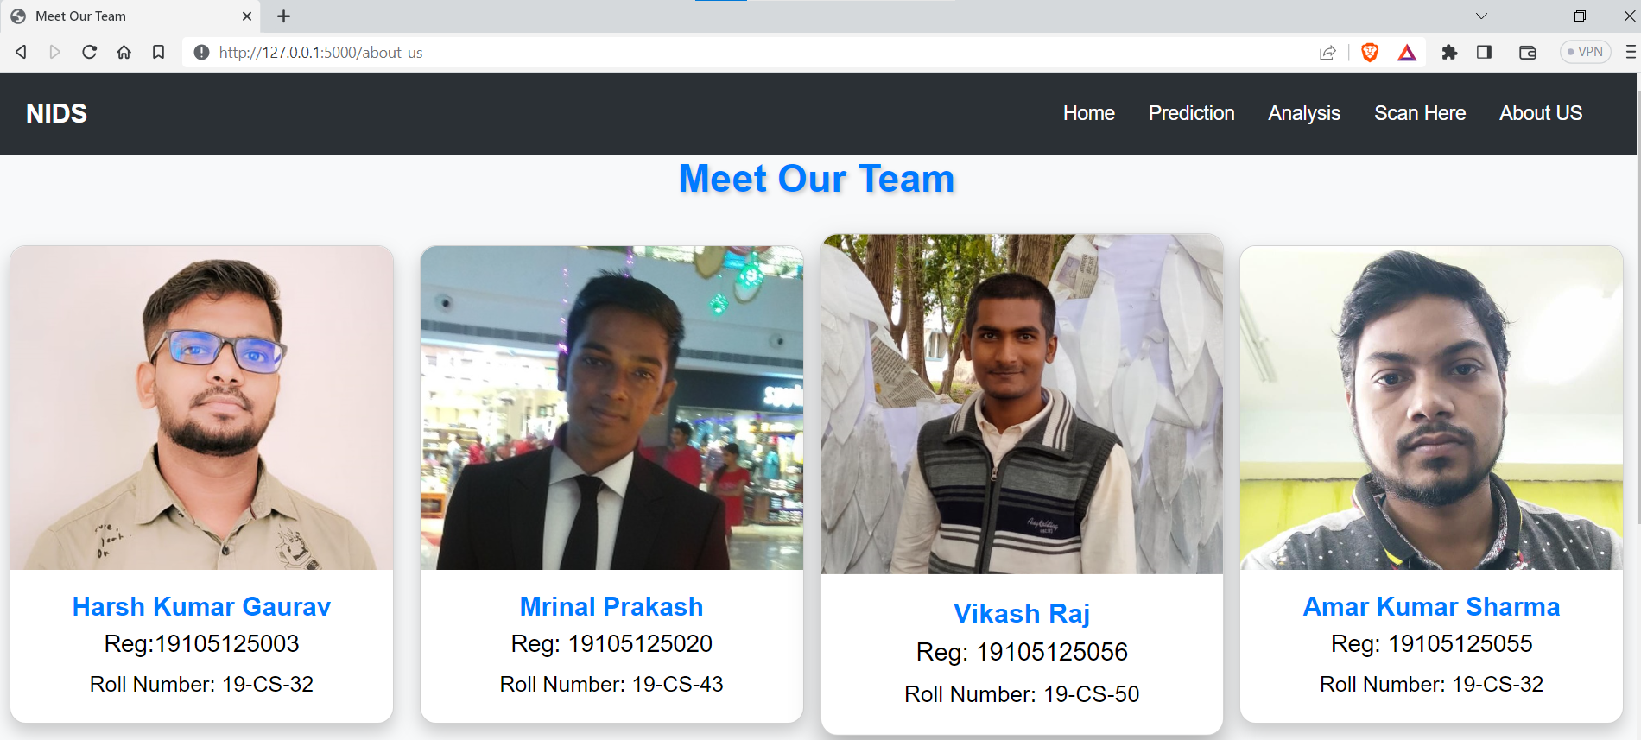


Slide 29

Challenges Faced
Inaccuracy for exploit based signatures
Cannot recognize unknown anomalies/intrusions.
Cannot tell the situational-aware info: attack scope/target/strategy, attacker(botnet) size,etc

Slide 30

Limitation of NIDS
Encrypted Traffic Inspection: NIDS faces challenges in inspecting encrypted network traffic.
Blind Spots: NIDS operates at specific points within the network architecture to capture and analyze network traffic.
Intrusion Detection Delays: NIDS relies on the analysis of network packets to detect intrusions.
Signature Dependency: NIDS primarily relies on signature-based detection, making it less effective in detecting

Slide 31
Conclusion
It offers a powerful and comprehensive approach to detecting and mitigating security threats within a network or system.
It enhance accuracy and effectiveness.
The generation of alerts and notifications allows security personnel to promptly investigate and respond to potential intrusions or suspicious activities.
It combines the strengths of signature-based and anomaly-based detection to provide a higher level of security and minimize false positives and false negatives.
Regular updates and refinements to the hybrid IDS's detection mechanisms ensure its continued effectiveness in identifying and mitigating security breaches.

Slide 32
FUTURE OF IDS
AI and Machine Learning Integration
Machine learning can analyse vast amounts of data and identify patterns, leading to more accurate and proactive threat detection.
Behaviour-Based Analysis
IDS will focus more on behaviour-based analysis, monitoring and learning normal patterns of users and systems to identify deviations that might indicate intrusions.
Cloud-Based IDS
Cloud-based IDS solutions will be designed to monitor and secure cloud infrastructures and applications.
Encryption and Privacy Challenges
Future IDS solutions will need to strike a balance between security monitoring and privacy concerns.

Slide 33
REFERENCES
https://github.com/CynthiaKoopman/Network-Intrusion-Detection
https://vdocument.in/intrusion-detection-system-project-report.html?page=1
https://github.com/Western-OC2-Lab/Intrusion-Detection-System-Using-Machine-Learning/blob/main/Tree-based_IDS_GlobeCom19.ipynb
https://www.youtube.com/playlist?list=PLZoTAELRMXVPgjwJ8VyRoqmfNs2CJwhVH

Slide 34


